Slide 1
Online Quize
By
Miss. Rutuja Kadam (MCA-I)
Miss. Shweta Kadam (MCA-I)

Slide 2
INTRODUCTION
The ONLINE QUIZE is a web application for to take online quize in an efficient manner and no time wasting for checking the paper. The main objective of ONLINE QUIZE is to efficiently evaluate the candidate thoroughly through a fully automated system that not only saves lot of time but also gives fast results. For students they give papers according to their convenience and time and there is no need of using extra thing like paper, pen etc. This can be used in educational institutions as well as in corporate world. Can be used anywhere any time as it is a web based application(user location doesn’t matter). No restriction that examiner has to be present when the candidate takes the test.
In order to solve these problems, we have developed a Web-based online test system which can create quizzes competitively and collaboratively by students for the purpose of reducing the load required for a teacher and promoting interactions among students and between the teacher and students.
There are 2 modules in the project are as follows :-
1.Admin
2.User

Slide 3
Existing System
The first problem is that there are loads of hard copied documents being generated.
The existing system is manual system. Needs to be converted into automated system.
Manual system face so many problem limitation avoid in new system.
In existing system there are several problems that we faces in a common way. Some of those problems are.
Manual system requires pen/ pencils and paper.
Teacher needs to spend time to script checking.
Student needs to wait to get their result up to the teacher finishes the script checking

Slide 4
Proposed System
This Web Application provides facility to conduct online examination.
It saves time as it allows number of users to give the exam at a time and displays the results as the quize gets over, so no need to wait for the result.
It is automatically generated by the server.
Admin has a privilege to create and delete the quize.
User can register, login and give the quize with his specific id, and can see the results as well.

Slide 5
Module Description
User Registration - This module is for the users who do not have their account. Here user is allowed to create an account to login. The account creation is done by filling the registration form with user details such as name, email,college name etc.
Admin- The admin module leads to admin dashboard which is accessible through admin login and he/she able to see all the users and manage them. The admin dashboard allows admin to add new quize into system along with 4 options and 1 right answer and also admin can remove the quize. The admin can view ranking of quize as well as feedback given by users.
User-The user can login to the system and view all the Quize and solve it.User can see history as well as ranking of the quize. User is able to give the feedback.

Slide 6
S/W and H/W Requirements
Server
Client
Name | Details
Processor | Intel core i3
RAM | 512 MB (or Above).
HDD | 4 GB (or Above).
Name | Details
Processor | Intel core i3
RAM | 512 MB (or Above).
HDD | 4 GB (or Above).
Software Requirement
Name | Detail
Operating System | Windows 7 or above
Web Browser | Browser Compatible
Development Tool | HTML,CSS,php,java script.bootstrap
Database | MySQL

Slide 7
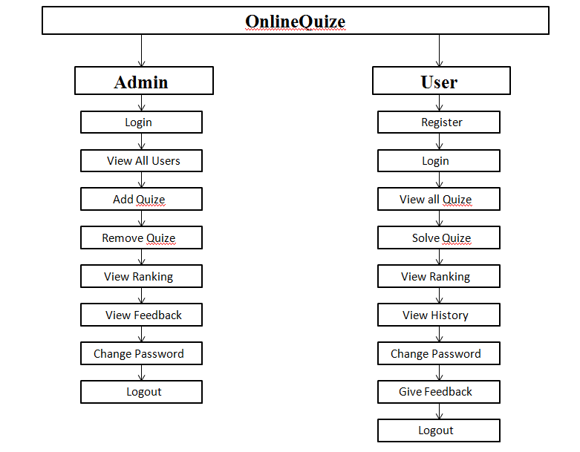
Module hierarchy diagram

Slide 8
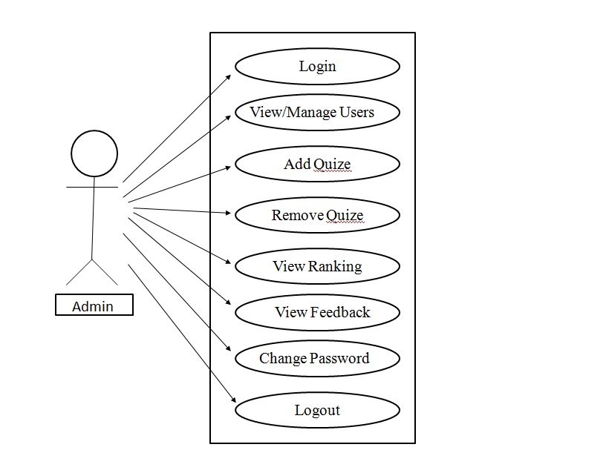
Admin Use Case Diagram

Slide 9
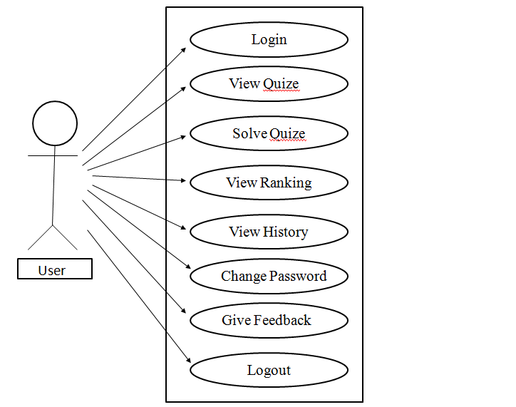
User Use Case Diagram

Slide 10
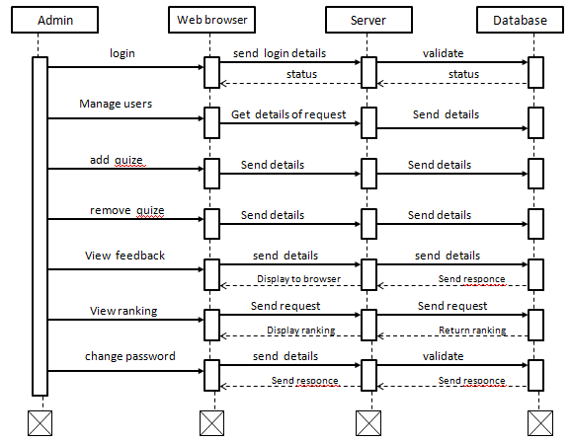
Admin Sequence Diagram

Slide 11
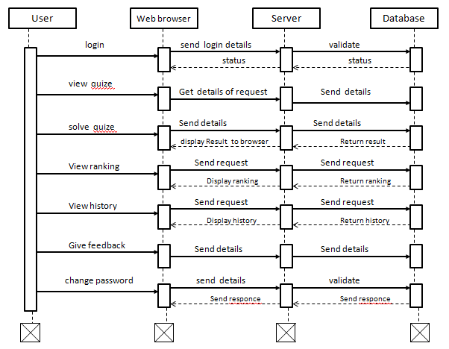
User Sequence Diagram

Slide 12
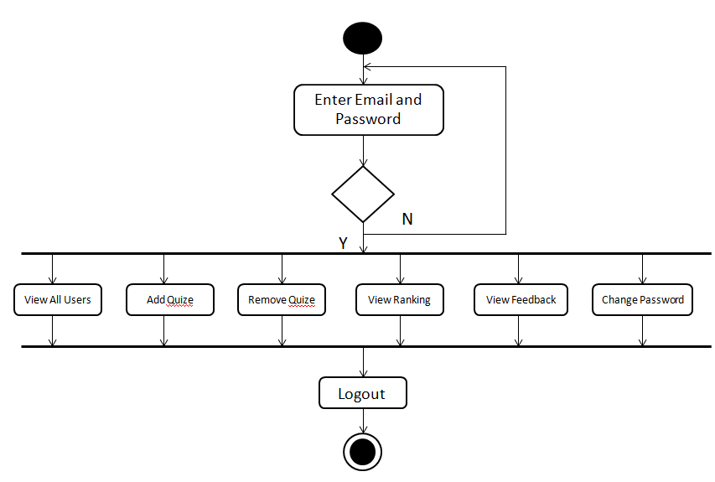
Admin Activity Diagram

Slide 13
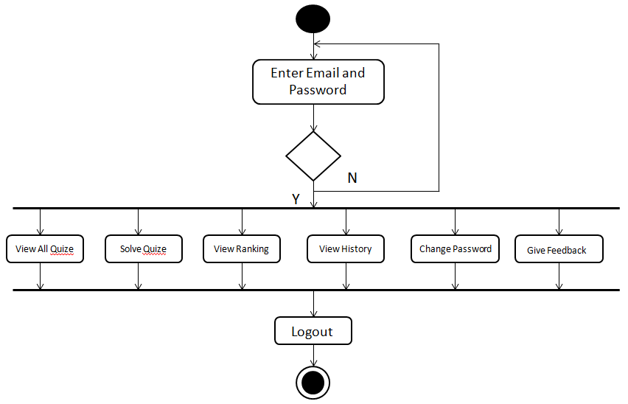
User Activity Diagram

Slide 14
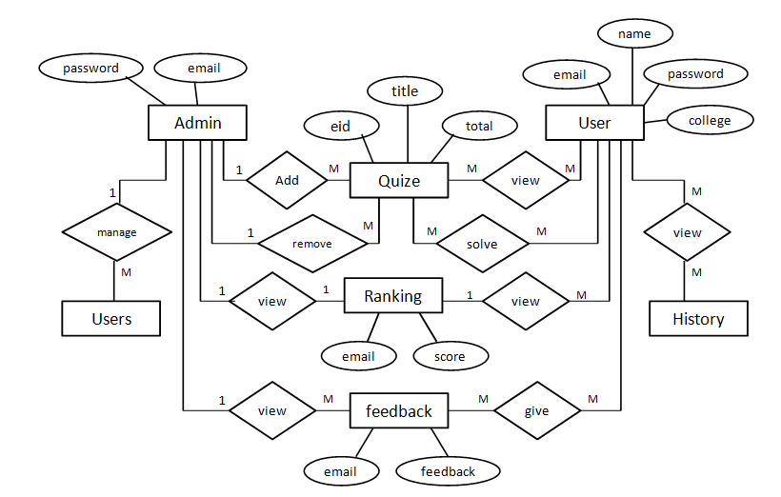
Entity Relationship Diagram (ERD)

Slide 15
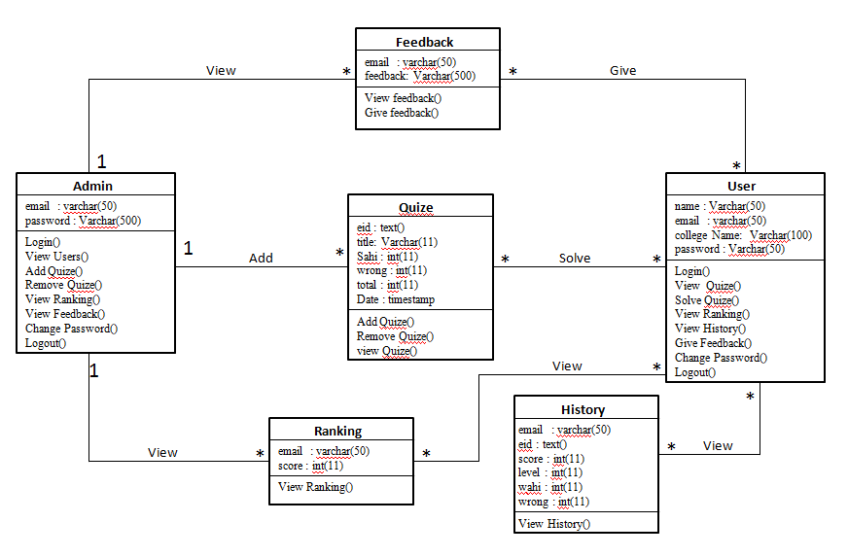
Class Diagram

Slide 16
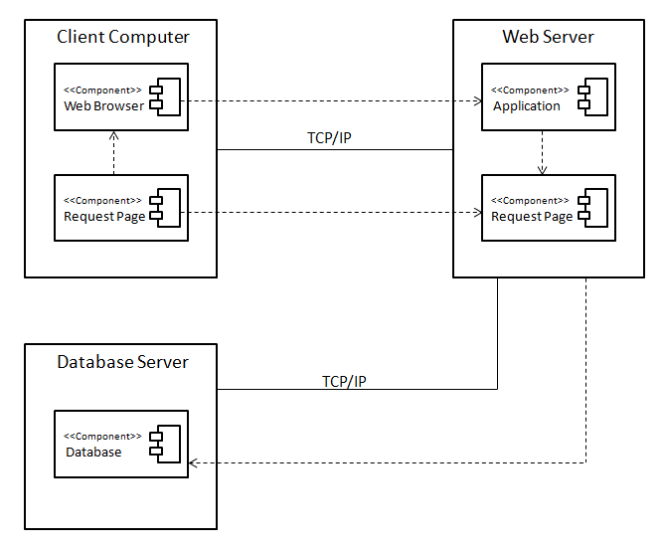
Deployment Diagram

Slide 17
Data Tables
Admin Table
Column Name | Data Type | Constraint | Description
admin_id | Int (11) | NOT NULL | Admin Id
email | Varchar (50) | Primary Key | E-mail
password | Varchar (50) | NOT NULL | Password
User Registration Table
Column Name | Data Type | Constraint | Description
name | Varchar (50) | NOT NULL | Username
college | Varchar (100) | NOT NULL | College Name
email | Varchar (50) | Primary Key | E-mail
password | Varchar (50) | NOT NULL | Password
Questions Table
Column Name | Data Type | Constraint | Description
Eid | Text | Foreign Key | Panel Id
Qid | Text | Primary Key | Question Id
Qns | Text | NOT NULL | Question
choice | Int (10) | NOT NULL | No. of Options
Sn | Int (10) | NOT NULL | Serial No.

Slide 18
Options Table
Column Name | Data Type | Constraint | Description
Qid | Varchar (50) | Foreign Key | Question Id
option | Varchar (5000) | NOT NULL | Options
optionid | Text | Primary Key | Option Id
Quiz Table
Column Name | Data Type | Constraint | Description
eid | Text | Primary Key | Panel Id
title | Varchar (100) | NOT NULL | Title of Quiz
sahi | Int (11) | NOT NULL | Right Answers
wrong | Int (11) | NOT NULL | Wrong Answers
total | Int (11) | NOT NULL | Total No.of Question
date | Timestamp | NOT NULL | Date
Answer Table
Column Name | Data Type | Constraint | Description
qid | Text | Foreign Key | Question Id
ansid | Text | Primary Key | Answer Id

Slide 19
Rank Table
Column Name | Data Type | Constraint | Description
email | Varchar (50) | Foreign Key | E-mail
score | Int (11) | NOT NULL | Quize Score
time | Timestamp | NOT NULL | Time
History Table
Column Name | Data Type | Constraint | Description
email | Varchar (50) | Foreign Key | E-mail
eid | Text | Foreign Key | Title of Quiz
score | Int (11) | NOT NULL | Quize Score
level | Int (11) | NOT NULL | No. of Solved Que
sahi | Int (11) | NOT NULL | Right Answers
wrong | Int (11) | NOT NULL | Wrong Answers
date | Timestamp | NOT NULL | Date
Feedback Table
Column Name | Data Type | Constraint | Description
email | Varchar (50) | Foreign Key | E-mail
feedback | Varchar (500) | NOT NULL | Feedback

Slide 20
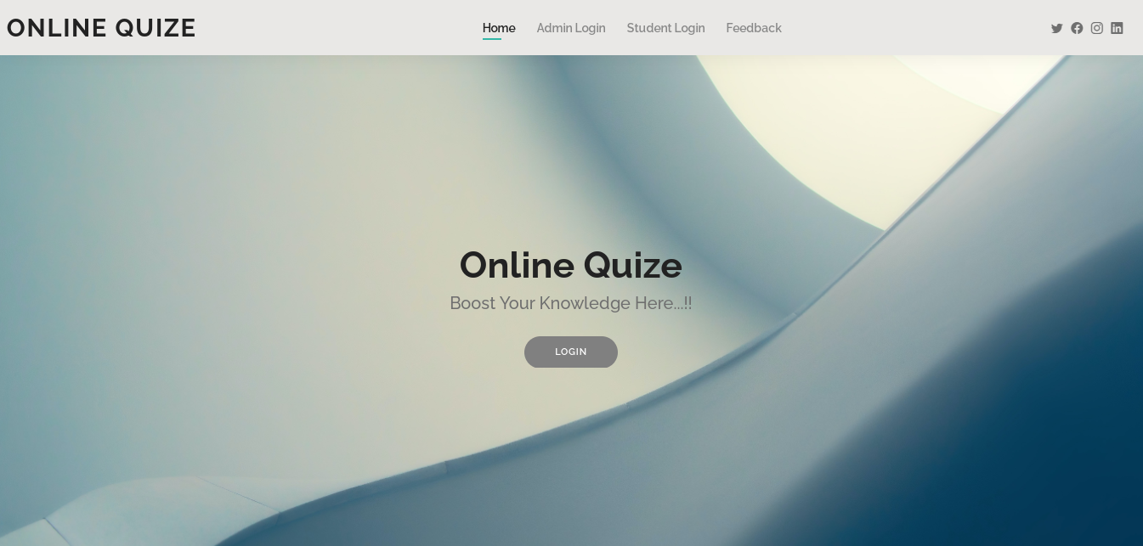
Screenshots
Home Page

Slide 21
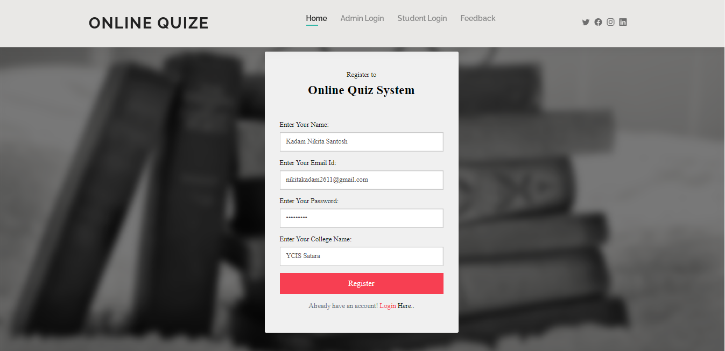
User Registration Page

Slide 22
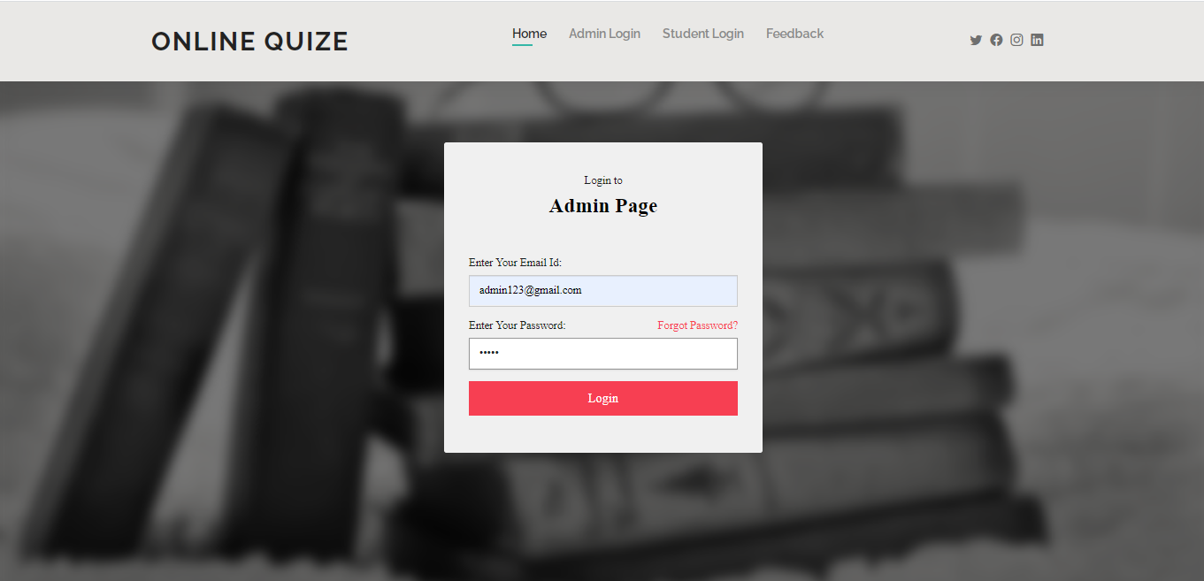
Admin Login Page

Slide 23
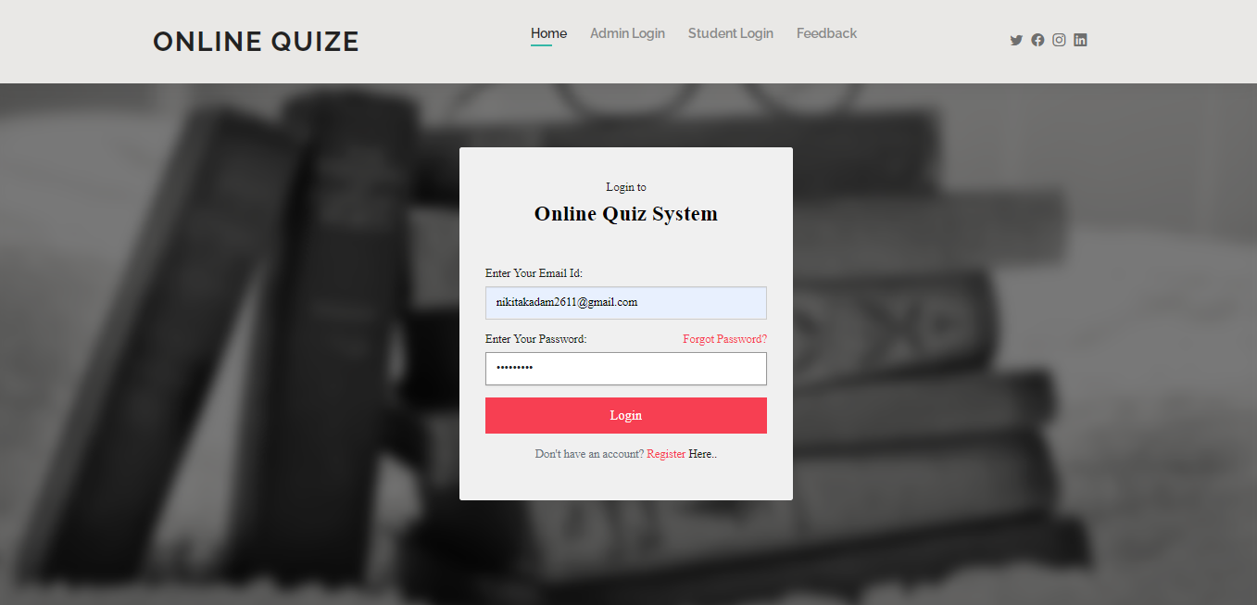
User Login Page

Slide 24
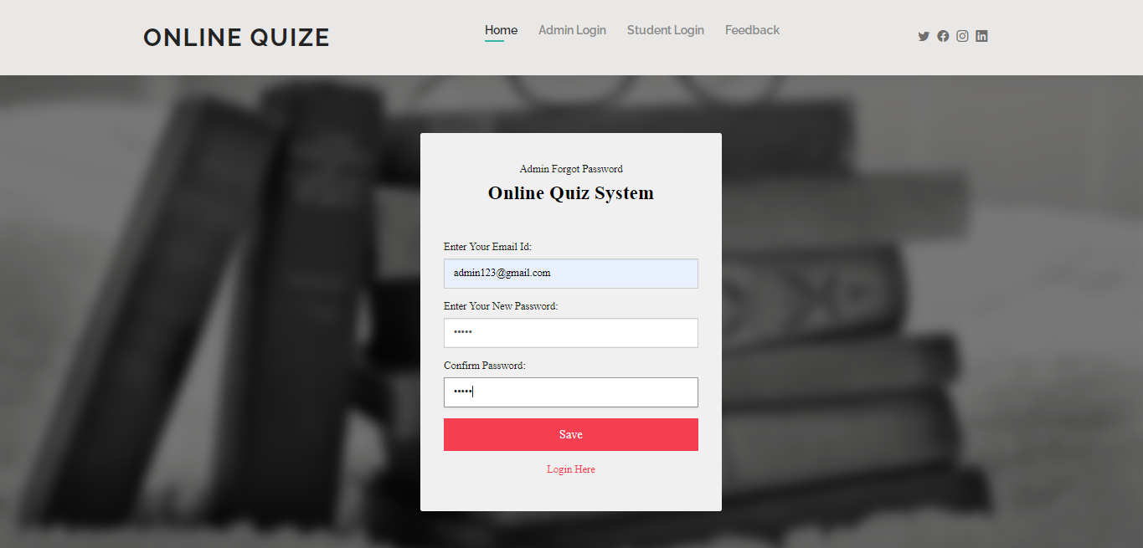
Admin Forgot Password Page

Slide 25
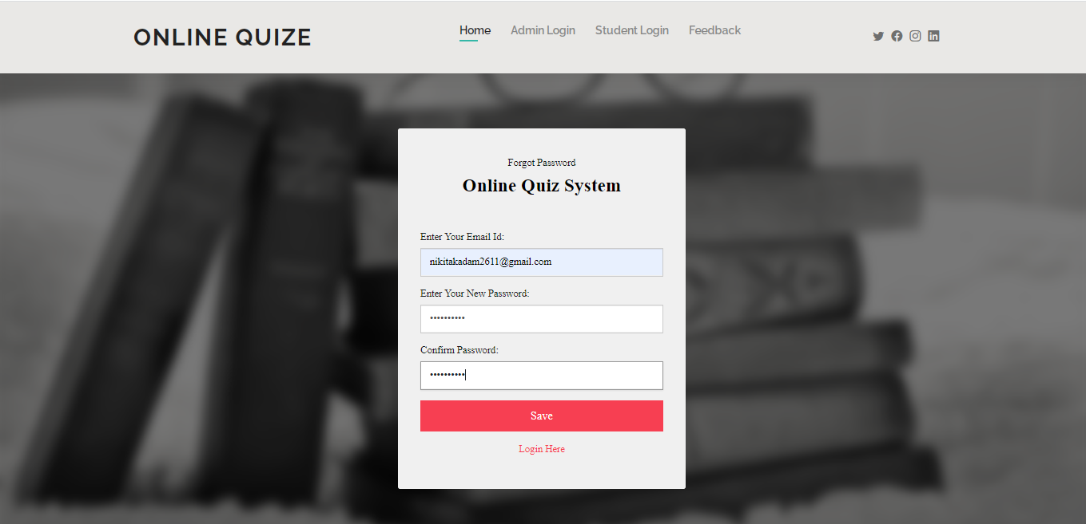
User Forgot Password Page

Slide 26
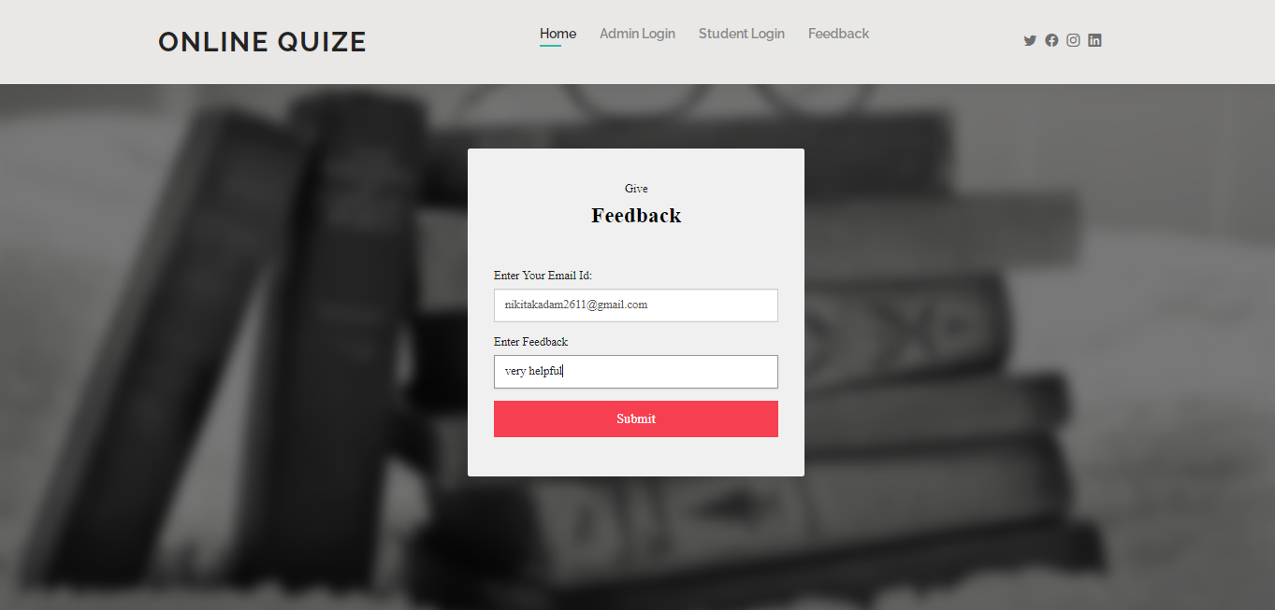
Feedback Page

Slide 27
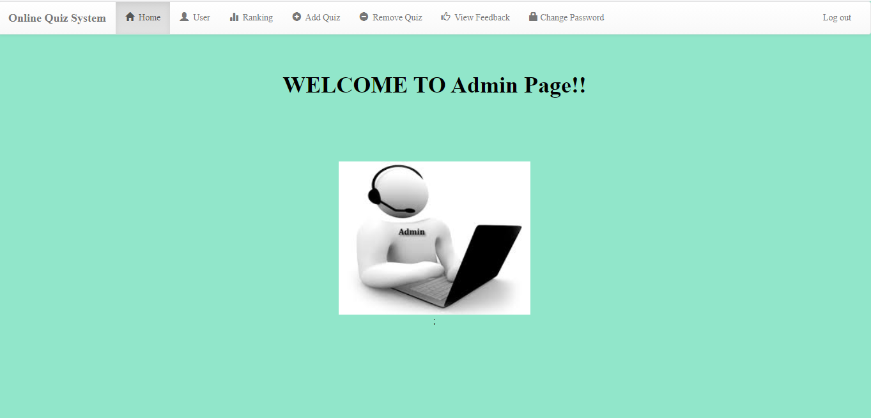
Admin Home Page

Slide 28
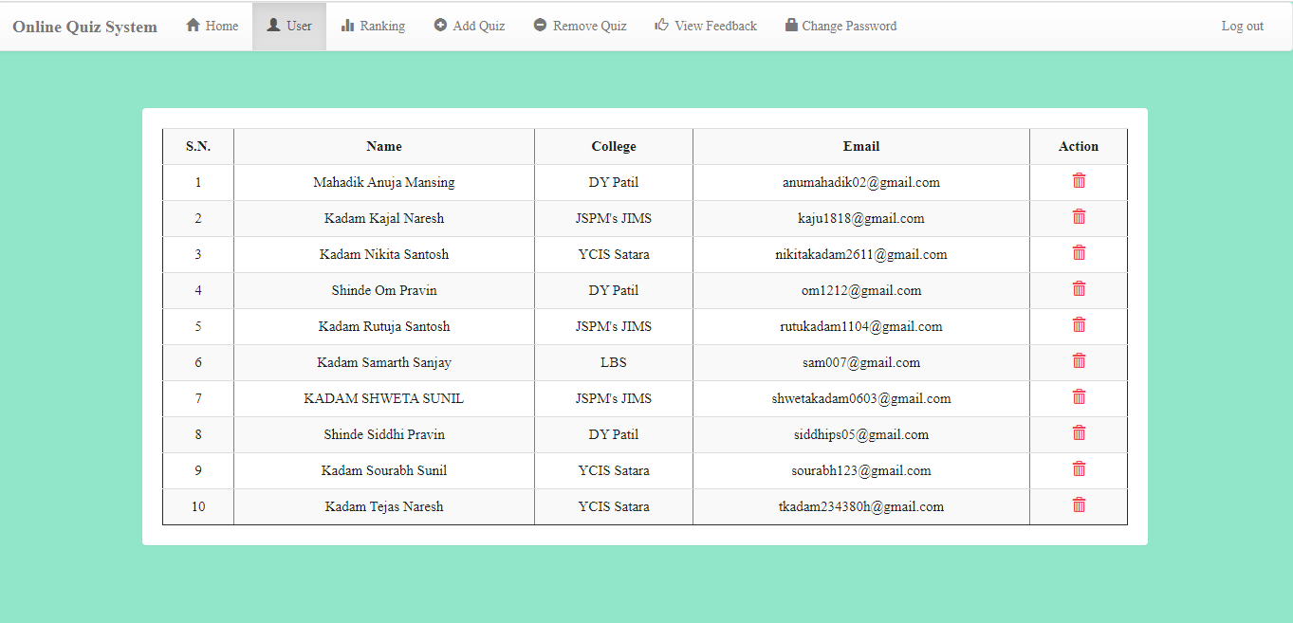
View Users Page

Slide 29
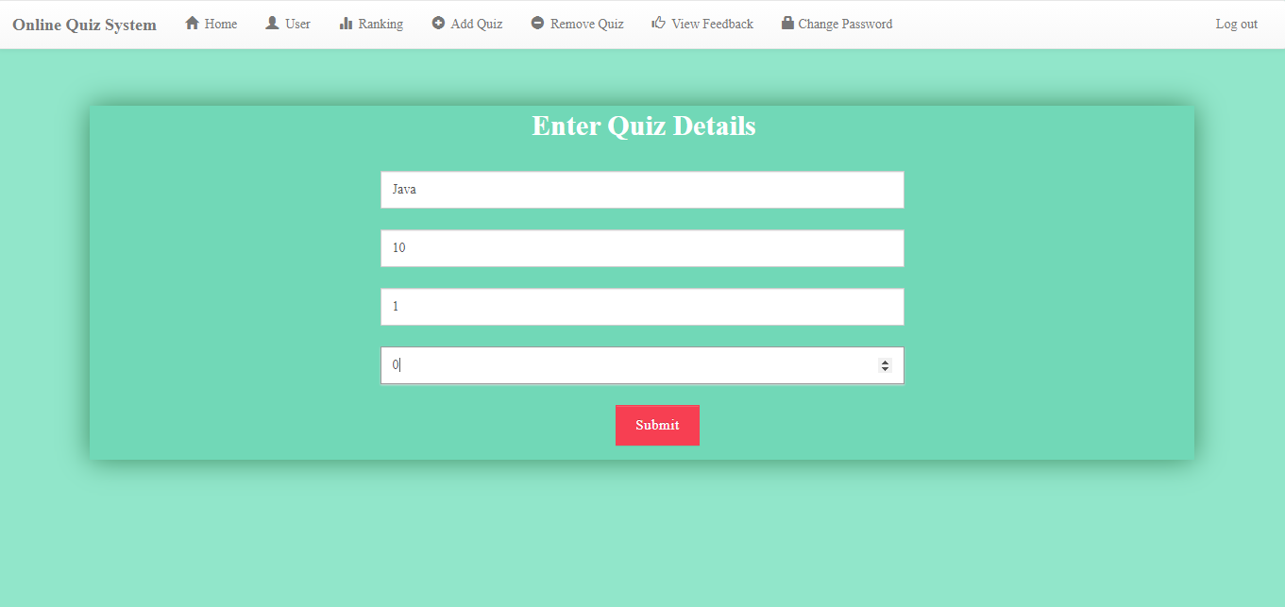
Add Quiz Page

Slide 30
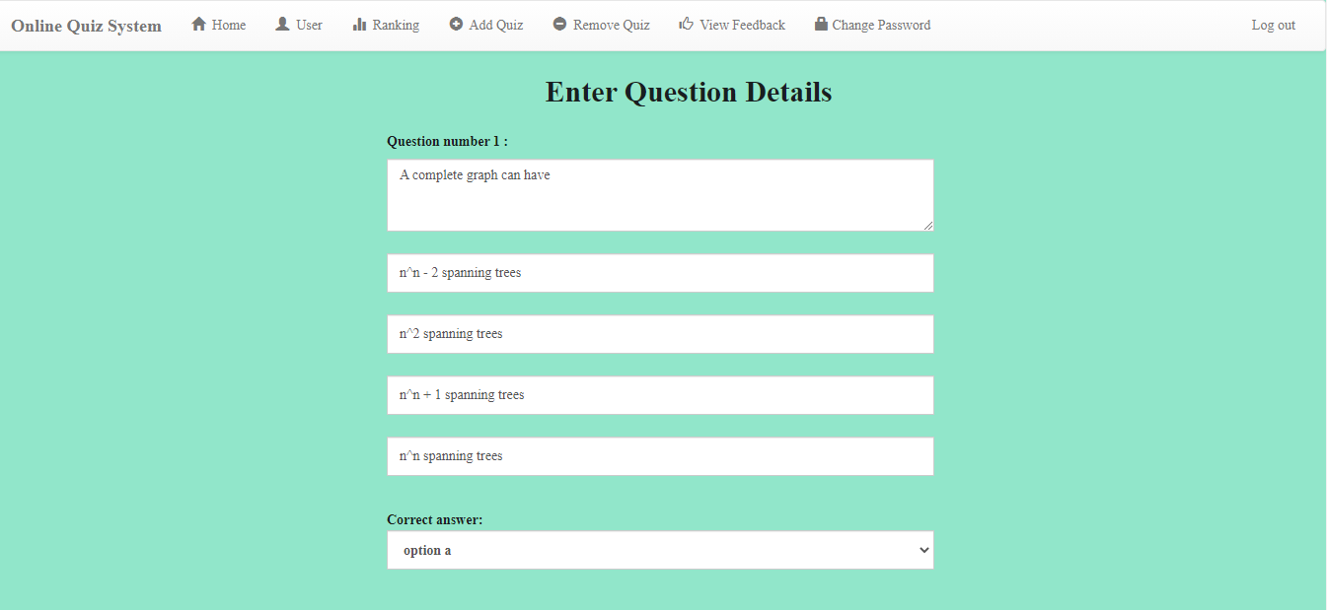
Add Questions Page

Slide 31
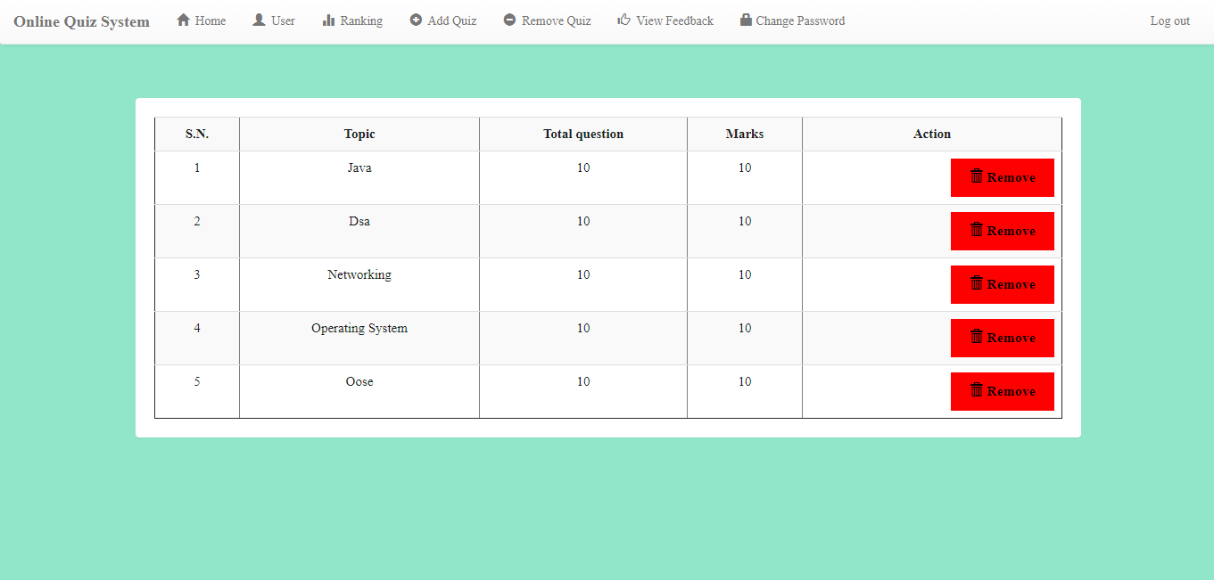
Remove Quiz Page

Slide 32
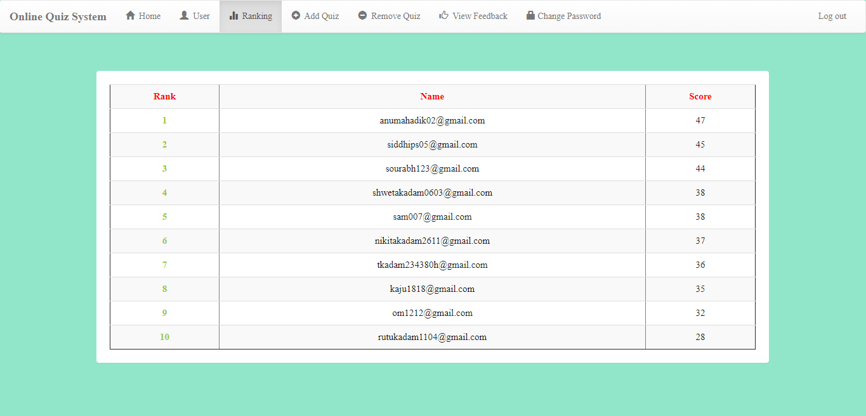
Ranking Page

Slide 33
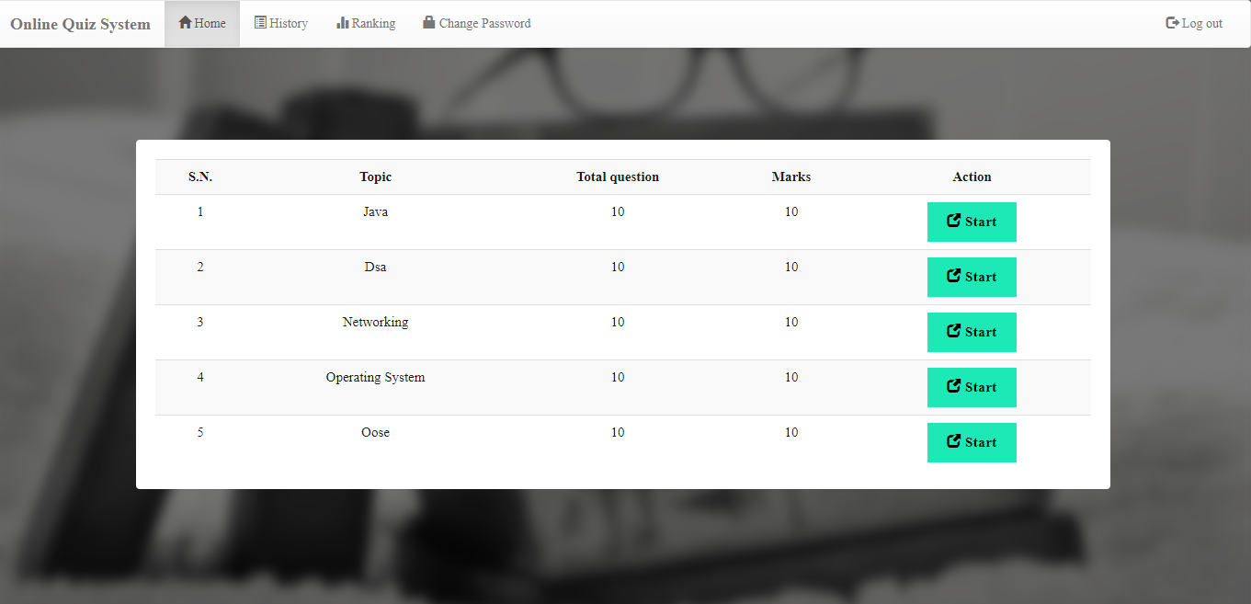
View Quiz Page

Slide 34
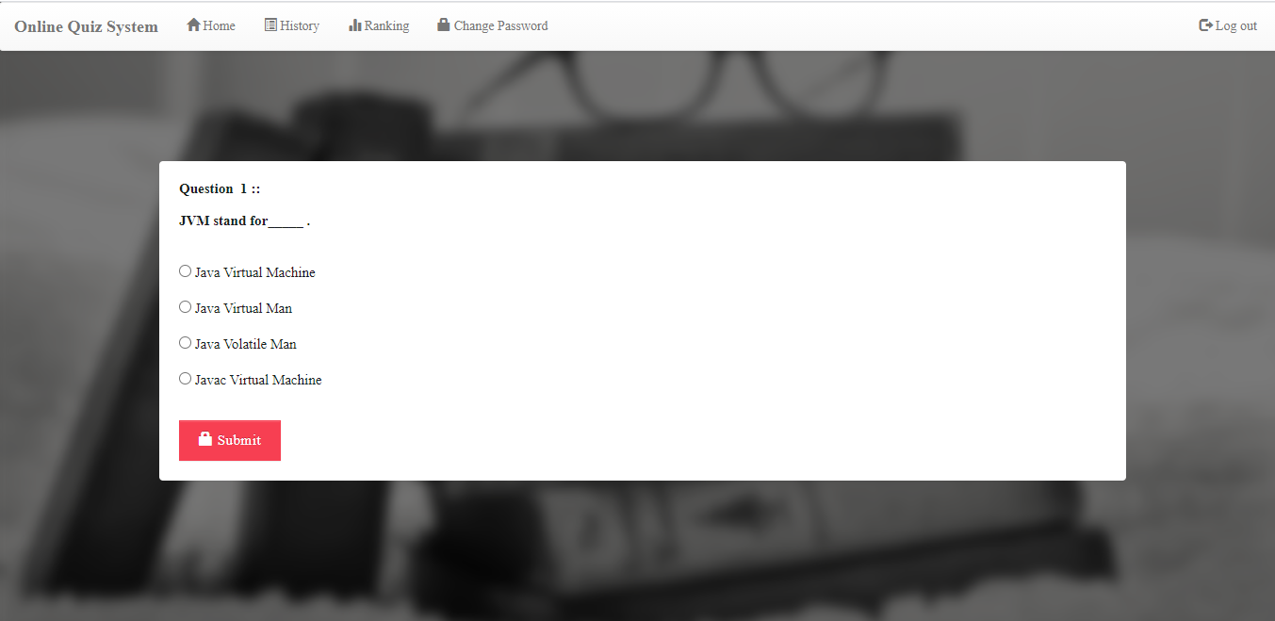
Solve Quiz Page

Slide 35
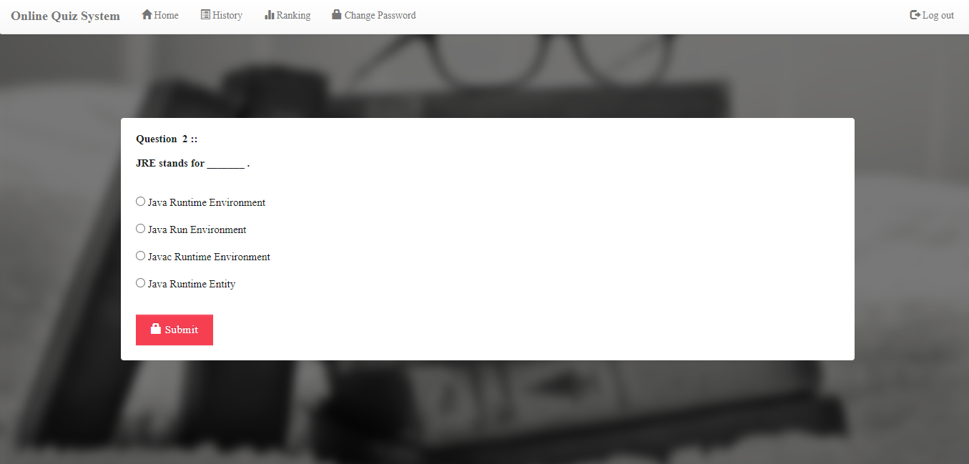

Slide 36
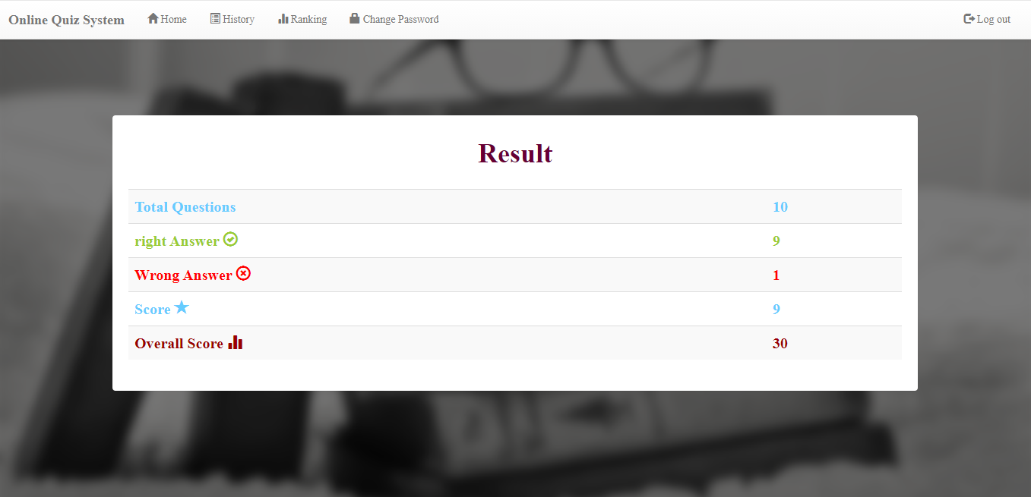
Result Page

Slide 37
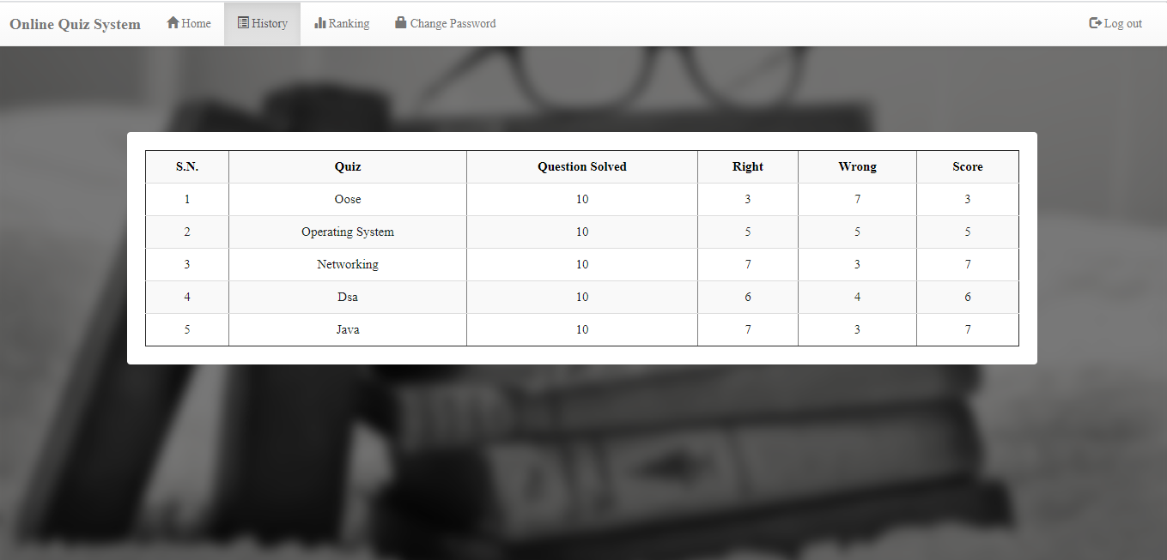
History Page

Slide 38
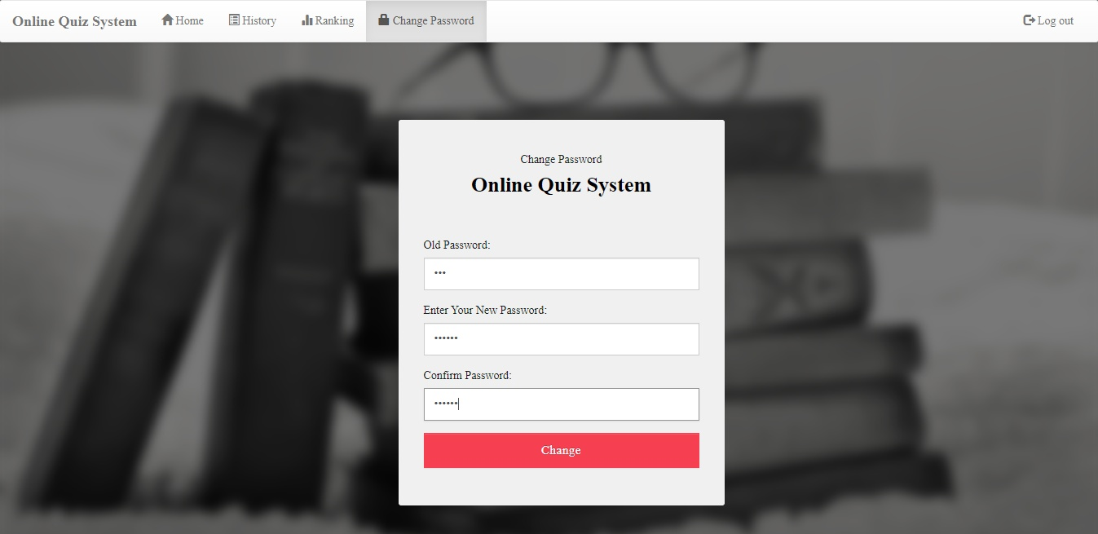
Change Password Page

Slide 39
Limitations
Each and every system has some limitations that can restrict then to work on a particular environment. Through our system is provided high amount of accuracy and quick data generation there is still some limitations that led us to in greater deficiency to work on that system. Some of the limitation that is observed during althe process is mentioned below.
The system is web-base application (website) so internet facility must be need.
This system is a web-base system so it may slow when more users accessing same Interface at same time.
Susceptible to Cheating
Current system provides only multiple choices but single currect answer selection.

Slide 40
Bibliography
WEBSITES
http://books.google.com
http://www.projectcode.com
http://www.W3Schools.com
http://www.stackoverflow.com
http://www.getbootstrap.com

Slide 41
Thank You

